Slide 1
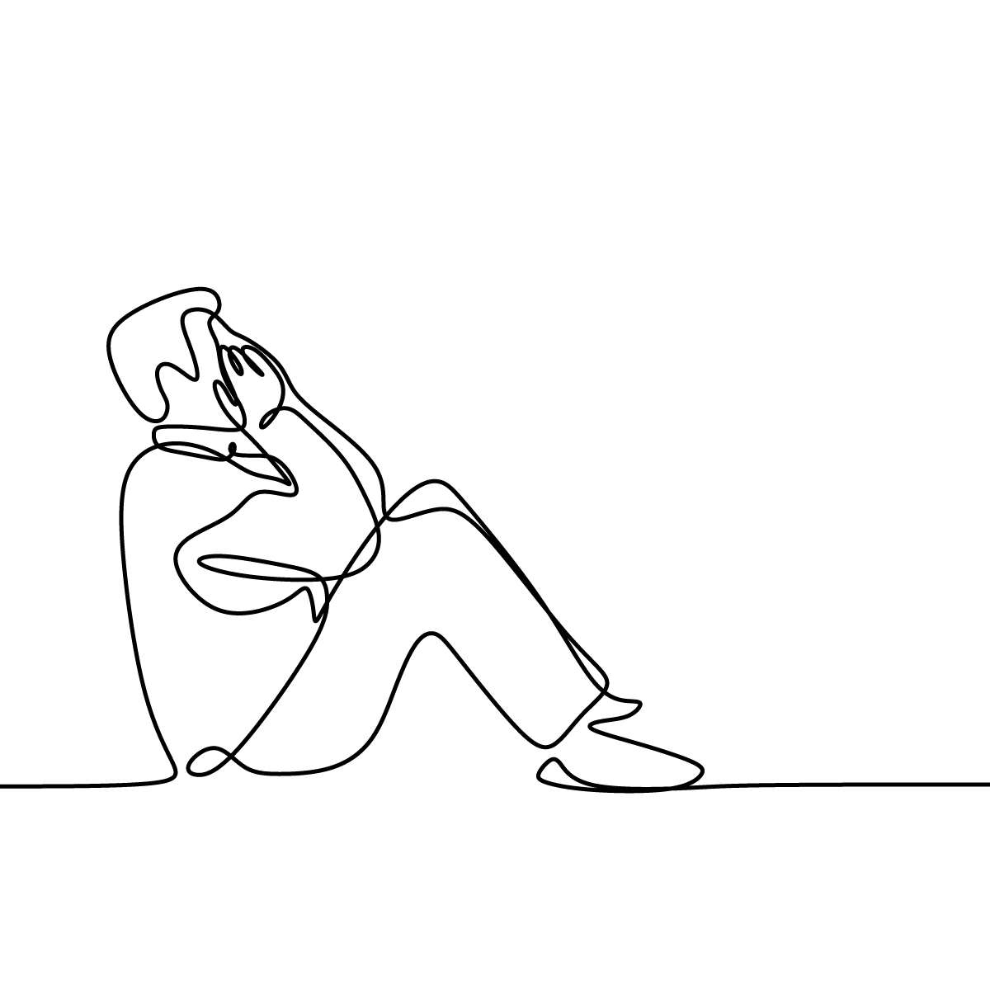
ANALYZE THE VARIABILITIES IN THE SPOKEN RESPONSE OF DEPRESSED VS NON-DEPRESSED.
TEAM 18
AMJITH S B (CSA, 21)
ANJALI MATHEW (CSA, 25)
HARSHA SANJAN (CSA, 62)
RANIYA (CSB, 45)
PROJECT GUIDE
DR. RENI K CHERIAN
DR. STARLET BEN ALEX

Slide 2
WHAT IS DEPRESSION ?
It is a serious mood disorder that has become one of the major diseases that threaten human mental health.
It causes a persistent feeling of sadness and changes the way they think.
It can also lead to negative thoughts and emotions.
Variabilities in Spoken Responses :
Pitch
Energy
Speech rate
Pause duration

Slide 3
PROBLEM STATEMENT
Analyze the variabilities in the spoken response of depressed vs non-depressed.
Hypothesis :
Response to same object would be differed from depressed to non-depressed.
Goal :
To find cues from the responses (speech and text) obtained from the depressed and non-depressed subjects

Slide 4
OBJECTIVE
Prepare emotional abstract words stimuli.
ANEW(Affective Norms of English Words) dataset
Collect spoken responses from the subjects in Indian English and their Native language.
Analyze the cues from the responses to detect a depressed population

Slide 5
LITERATURE STUDY
ANEW (Affective Norms of English Words) [1]
ANEW is a set of 1034 emotion evoking words.
It is rated in terms of pleasure, arousal, and dominance.
To assess the dimensions of pleasure, arousal, and dominance, the Self-Assessment Manikin (SAM) scale is used.
The two primary dimensions were one of affective valence (ranging from pleasant to unpleasant) and one of arousal (ranging from calm to excited).

Slide 6
2. “Self-Reported Depression Is Associated With Aberration in Emotional Reactivity and Emotional Concept Coding” [2]
Focuses on the connection between subjective depression and emotional processing among people.
The participants were instructed to rate the valence and arousal of each word on a 9-point Likert scale using the Self-Assessment Manikin (SAM) scale.
Used 15 emotional abstract words and were pre-categorized equally into five emotional categories: HVHA emotion words, HVLA emotion words, LVHA emotion words, LVLA emotion words, NAs words.

Slide 7
A grouping of participants into self-reported non-depressed (ND) and depressed (D) using BDI was also done.
A score of more than 14 on the BDI scale were placed in the depressed group, and individuals scoring between 2 and 8 in this scale were placed in the non-depressed group.
In comparison with healthy people a depressive person responds minimally in positive emotions and has a higher level of sadness.

Slide 8
3. “Emotion Label from ANEW dataset for Searching Best Definition from WordNet” [3]
The valence and arousal scale used in this study selects values for each five category.
The Self-Assessment Manikin (SAM) scale, which is the basis for the valence and arousal ratings, uses a range of values from 1 to 9.
The valence dimension represents the horizontal axis of the circumplex model of affect, while the arousal dimension represents the vertical axis.
The center of the circle represents a neutral level of valence and arousal.
Using Tripartition Labeling Scheme, the scale is divided into three ranges [1.0–3.0], [4.0–6.0] and [7.0–9.0],given as the partitions Low, Medium and High respectively.

Slide 9
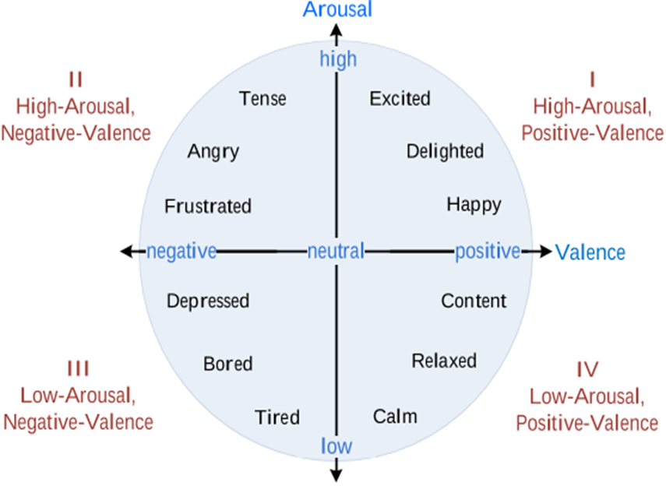
Figure 1 : Circumplex model

Slide 10
4. “A hybrid model for depression detection using deep learning” [4]
This study uses the DAIC-WOZ depression database which contains audio, video, and text responses from people with and without depression automatic depression detection.
The system achieved 0.89 and 0.90 accuracy in detecting depression and stress by using machine learning (ML) and deep learning (DL) algorithms, especially CNN and Bi-LSTM.
CNN takes less time to process than other algorithms and can be used for, speech and text recognition, and natural language processing.
The introduction of bidirectional LSTM (Bi-LSTM) continues to improve the model’s ability.
Bi-LSTM has better learning rates than the LSTM model with accuracy 88%.

Slide 11
5. “Estimating Severity of Depression From Acoustic Features and Embeddings of Natural Speech” [7]
The study proposes a method using a multi-task learning approach with a convolutional neural network (CNN) to estimate depression severity from speech audio.
Speech samples are analyzed to extract acoustic features like Mel filter bank spectrum and excitation source based values like aperiodic and F0 using WORLD vocoder system.
The model incorporates both sentiment and emotion classifications to improve depression severity estimation.
The combination of acoustic features, sentiment/emotion embeddings, and a multi-task CNN leads to more accurate depression severity assessment.

Slide 12
DESIGN & METHODOLOGY

Slide 13
DATA COLLECTION
PARTICIPANTS
People in the age group of 18 - 35
Fluent in Indian English and Malayalam
Consent and willingness of participants
Confidentiality and anonymity as regards their replies.
Collected data from 75 Male and 75 Female participants.
Figure 2 : Participant ratio

Slide 14
STIMULI
15 emotion evoking words from ANEW dataset
3 words from each of the 5 categories
Neutral (N)
Low valence and Low arousal (LVLA)
Low valance and High arousal (LVHA)
High valence and High arousal (HVHA)
High valence and Low arousal (HVLA)
Category | Valence | Arousal
Neutral | 5 - 5.4 | 2 - 3.15
LVLA | 1 - 3.4 | 1 - 3.4
LVHA | 1 – 2.5 | 7.5 - 9
HVLA | 7 - 9 | 1 - 3
HVHA | 7.5 - 9 | 7.7 - 9
Table 1 : Category Scale

Slide 15
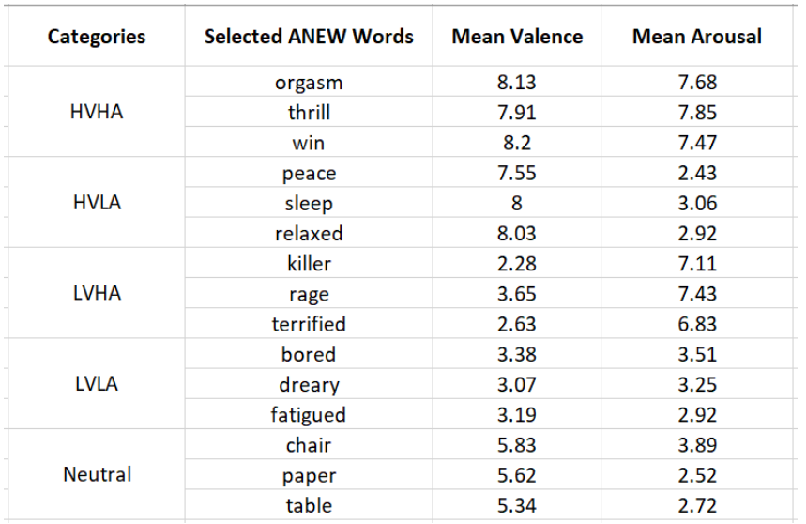
Selected ANEW Words and their corresponding valence and arousal ratings.

Slide 16
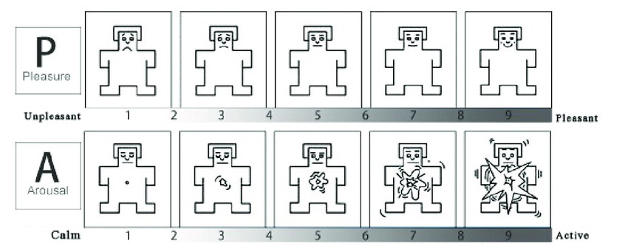
Participants were asked to perform three tasks:
Affective Rating Task
Participants were instructed to rate the words presented to them in two scales
Valence scale(range: 1 = extremely unpleasant; 9 = extremely pleasant)
Arousal scale(range: 1 = not at all arousing; 9 = extremely arousing)
Figure 3: Self-Assessment Manikin(SAM) scale

Slide 17
Property Generation Task
Participants were instructed to verbally express their thoughts, feelings and memories.
Response duration should be minimum of 20 seconds.
Avoid using phrases, single word answers and definitions
Spoken responses were recorded using high-quality recording equipment in a controlled setting to ensure optimal audio clarity.
Mental Health Survey
Patient Health Questionnaire (PHQ-9)
The Patient Health Questionnaire (PHQ) is a self-administered version of the PRIMEMD diagnostic instrument for common mental disorders.The PHQ-9 is the 9-item depression module from the full PHQ.

Slide 18
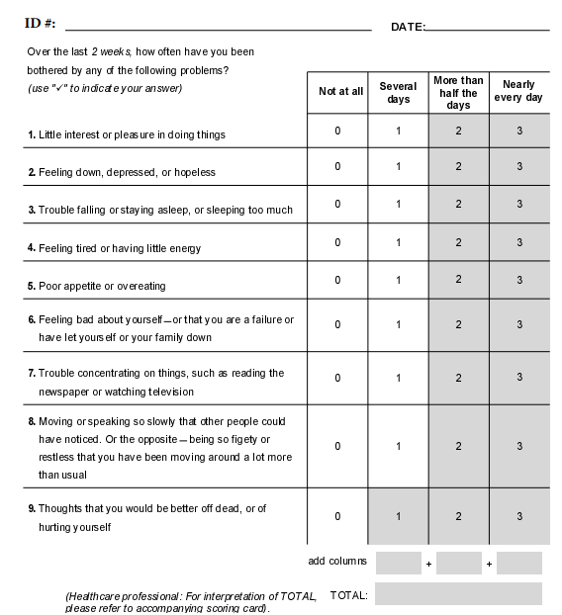

Slide 19
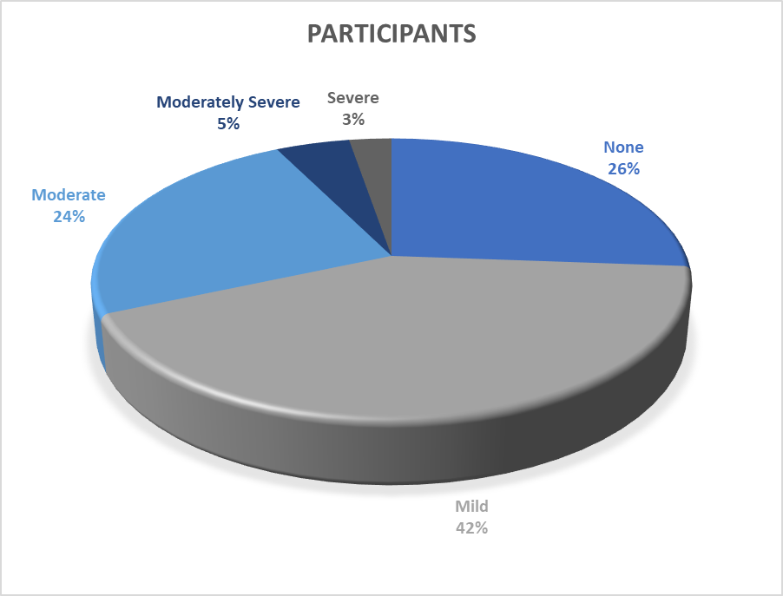
Total Score | Depression Severity
1 – 4 | Minimal depression
5 – 9 | Mild depression
10 – 14 | Moderate depression
15 – 19 | Moderately Severe depression
20 -27 | Severe depression
Table 2 : Category Score
Figure 4 : No. of participants

Slide 20
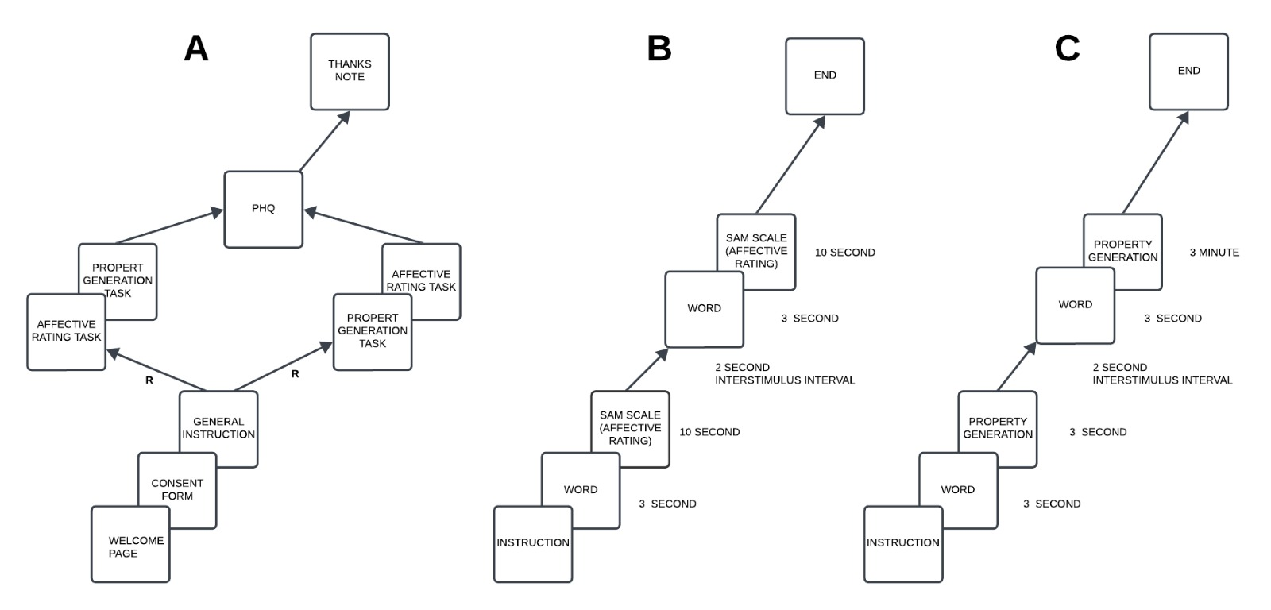
Figure 5 : Data collection procedure

Slide 21
DATA PREPROCESSING
Following are the preprocessing techniques:
Audio File Format Conversion and Renaming
Sampling Rate - 16 KHz
Feature Extraction
Mel-filterbank (MFB)
Aperiodicity
Fundamental frequency
Normalization - Mean Variance
Segmentation - Segment length:100
Labeling
Data splitting

Slide 22
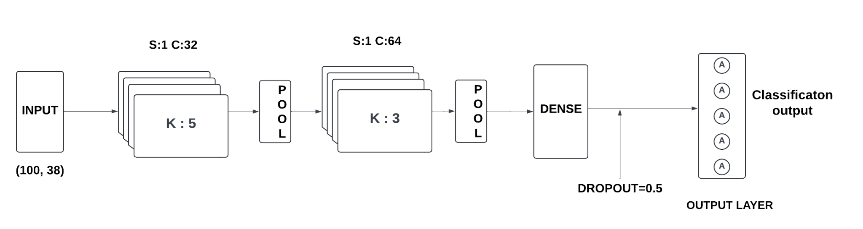
MODEL SELECTION
Inorder to analyze the variabilities we will be focusing on various deep learning models such as CNN, LSTM, BiLSTM.
CNN
Figure 6 : CNN Architecture

Slide 23
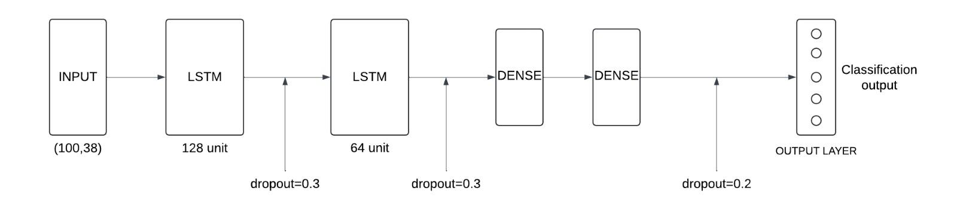
LSTM
Figure 7 : LSTM Architecture

Slide 24
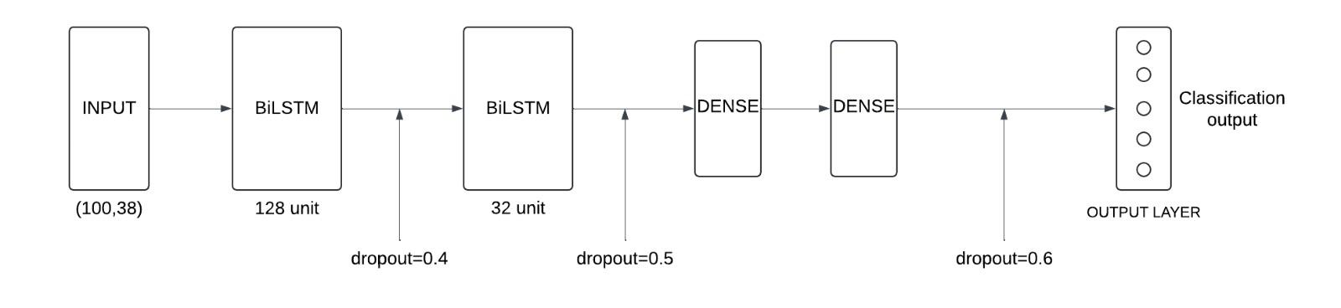
Bi-LSTM
Figure 8 : Bi-LSTM Architecture

Slide 25
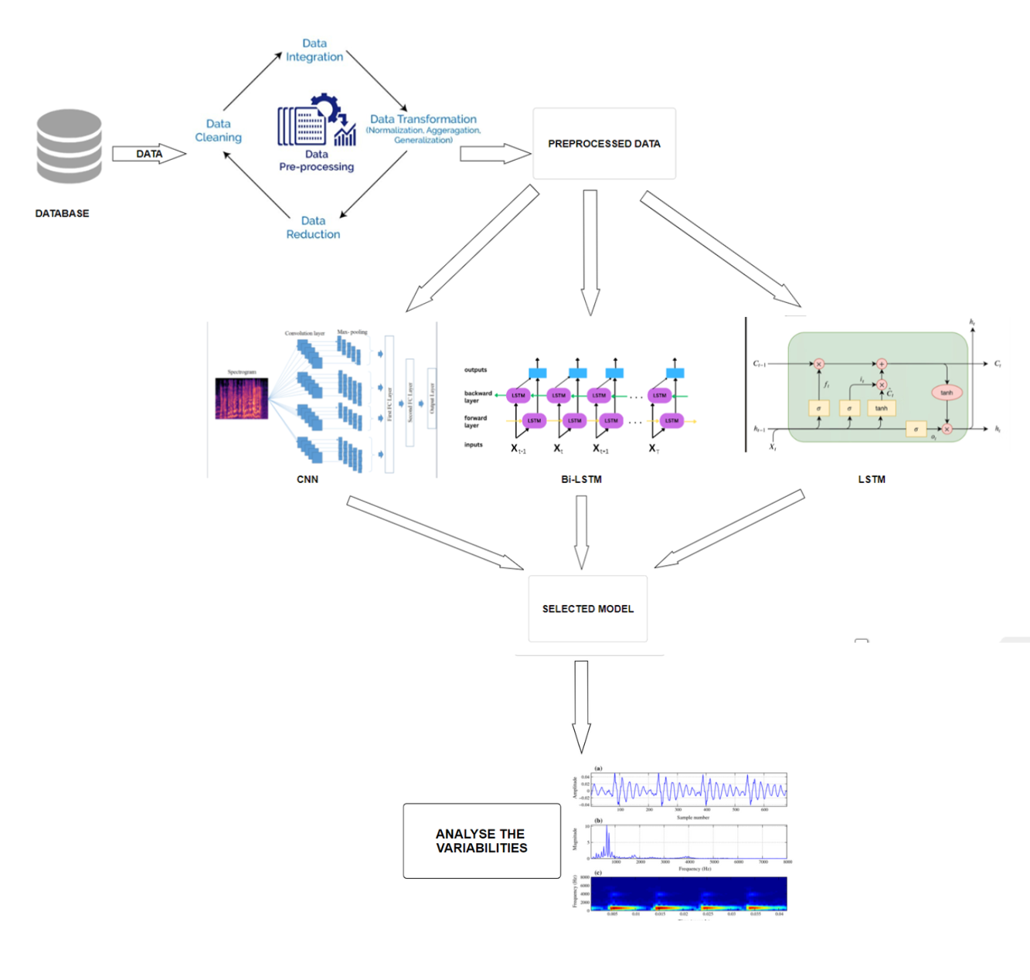
ACTIVITY DIAGRAM
Figure 9 : Activity diagram for analysing the variabilities in responses

Slide 26
RESULTS

Slide 27
MODEL PERFORMANCE
The performance evaluation of Convolutional Neural Network (CNN), Long Short-Term Memory (LSTM), and Bidirectional LSTM (Bi-LSTM) models for depression severity classification on audio datasets in Malayalam and English languages.
The models were evaluated on a held-out test set, using test loss and test accuracy as metrics.
Test loss measures the average error of the model on unseen data, with lower values indicating better performance.
Test accuracy represents the proportion of correctly classified depression severity levels in the test set, with higher values signifying better performance.

Slide 28
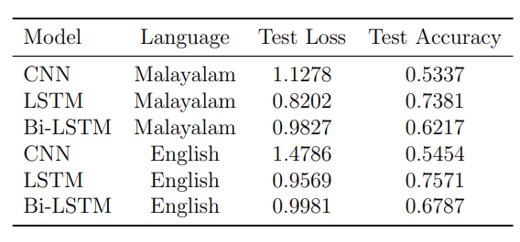

Slide 29
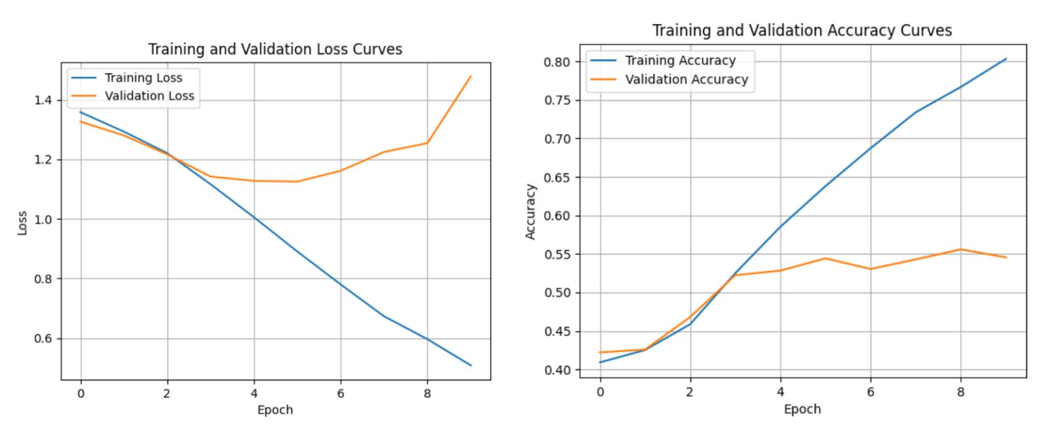
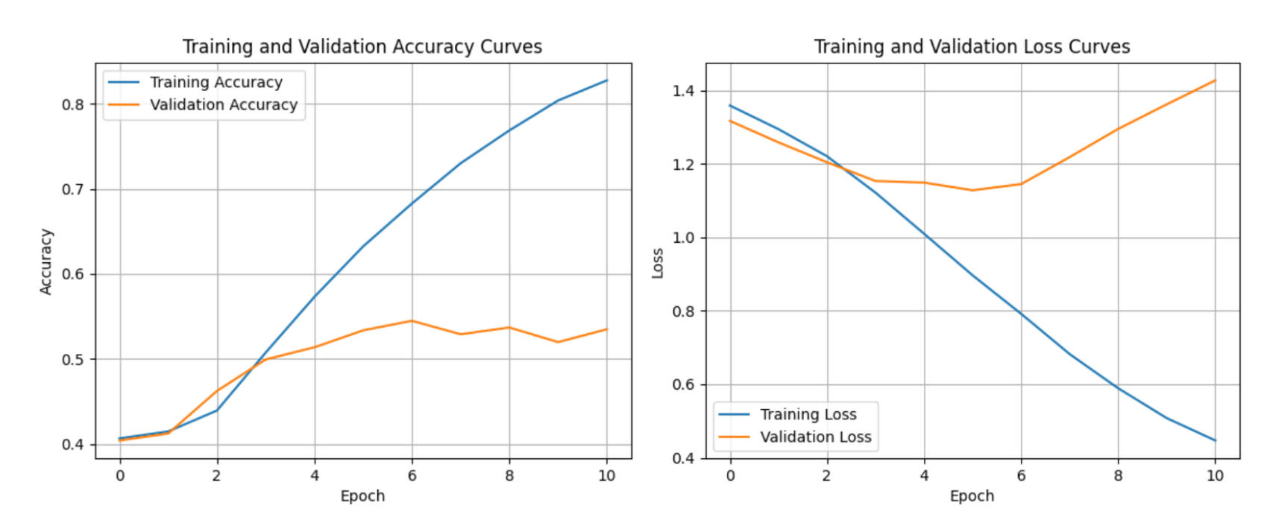
CNN Model Accuracy and Loss
English
Malayalam
Figure 10 : Comparison of CNN for both languages

Slide 30
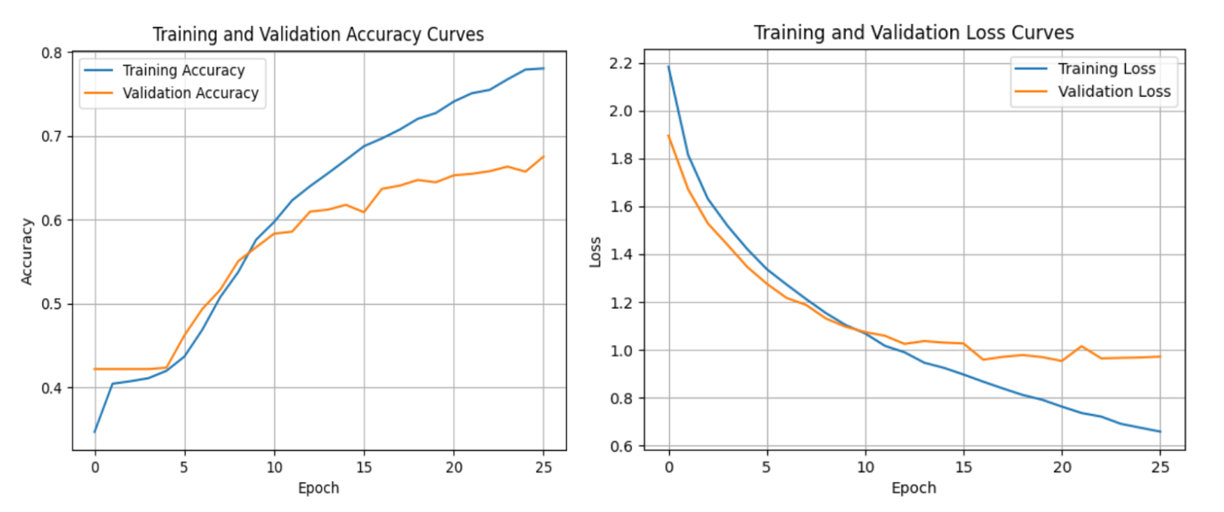
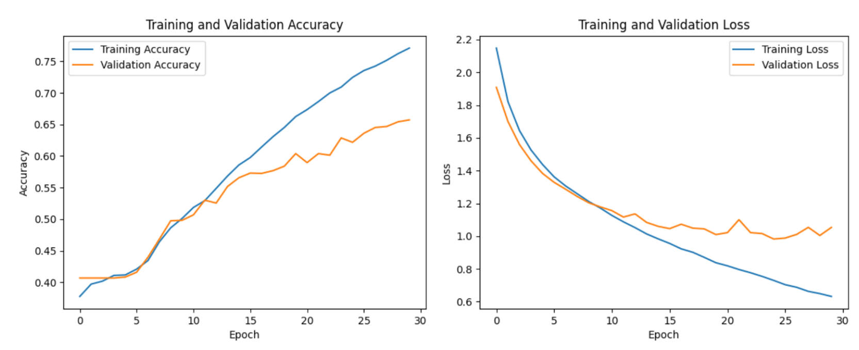
Bi-LSTM Model Accuracy and Loss
English
Malayalam
Figure 11 : Comparison of Bi-LSTM for both languages

Slide 31
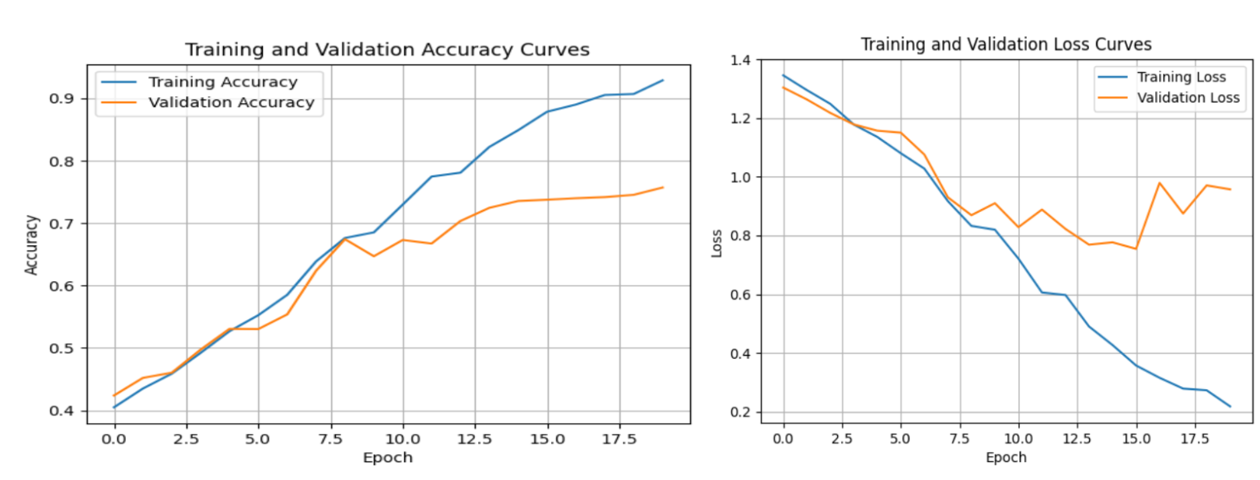
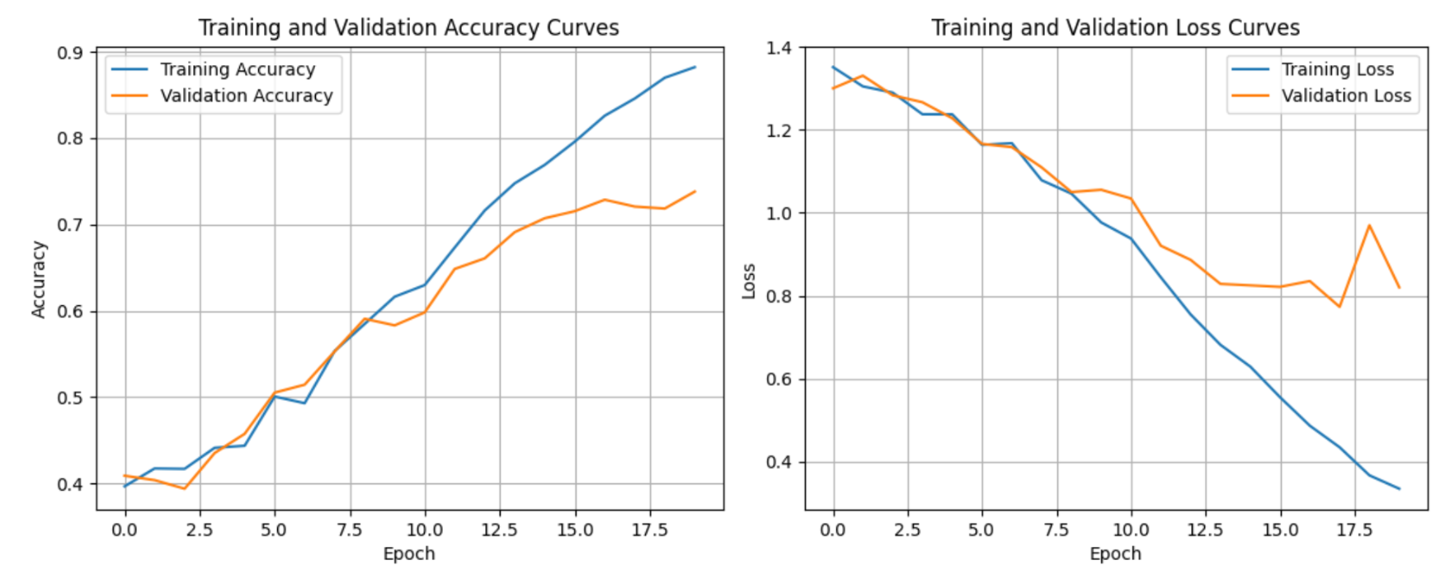
LSTM Model Accuracy and Loss
English
Malayalam
Figure 12 : Comparison of LSTM for both languages

Slide 32
CONCLUSION
LSTM models achieved the highest test accuracy in both Malayalam (0.738) and English (0.757).
LSTMs outperform CNNs, suggesting they better capture the sequential nature of audio features for depression classification.
Performance difference between Bi-LSTM and LSTM models was minor in both languages.
Malayalam dataset has lower accuracy than English, possibly due to dataset size, language complexity, or hyperparameter tuning.
Overall, LSTMs are effective for depression severity classification on audio data in both languages.

Slide 33
PROJECT TIMELINE
TASK | PROGRESS | START DATE | END DATE
1.Research and Analysis
Task 1: Ideation | 100% | 04-09-2023 | 07-09-2023
Task 2: Literature Study | 100% | 11-09-2023 | 25-09-2023
2.Data Collection
Task 1:Image and text categorization | 100% | 22-09-2023 | 26-09-2023
Task 2: Image and text Selection | 100% | 27-09-2023 | 02-10-2023
3.Response Collection Platform
Task 1:Google form creation | 100% | 03-10-2023 | 05-10-2023
4.Response Collection
Task 1: Collect Participants Responses | 100% | 06-10-2023 | 28-01-2024
Task 2: Label Collected Responses | 100% | 20-11-2023 | 06-02-2024
5.Model Building
Task 1: Feature Extraction | 100% | 15-02-2024 | 25-02-2024
Task 2: Model Design | 100% | 26-02-2024 | 01-03-2024
Task 3: Training & Optimizing Model | 100% | 02-03-2024 | 06-04-2024

Slide 34
REFERENCES
M.M Lang P. J. Bradley. Affective Norms of English Words (ANEW): Instruction manual and affective ratings. The Center for Research in Psychophysiology, University of Florida,1999.
Himansh Sheoran and Priyanka Srivastava. Self-reported depression is associated with aberration in emotional reactivity and emotional concept coding. Frontiers in Psychology,2022.
Maria Menezes, Anas Samara, Leo Galway, Anita Sant’Anna, Antanas Verikas, Fernando Alonso-Fernandez, H. Wang, and R. Bond. Towards emotion recognition for virtual environments: an evaluation of eeg features on benchmark dataset. Personal and Ubiquitous Computing, 21, 12 2017.
Vandana, Nikhil Marriwala, and Deepti Chaudhary. A hybrid model for depression detection using deep learning. Measurement: Sensors, 25:100587, 2023.
Karol Chlasta, Krzysztof Wo lk, and Izabela Krejtz. Automated speech-based screening of depression using deep convolutional neural networks. Procedia Computer Science, 164:618–628, 2019.
Tegar Satrio Utomo, Riyanarto Sarno, and Suhariyanto. Emotion label from anew dataset for searching best definition from wordnet. pages 249–252, 2018.
S. H. Dumpala, S. Rempel, K. Dikaios, M. Sajjadian, R. Uher and S. Oore, “Estimating Severity of Depression From Acoustic Features and Embeddings of Natural Speech,” ICASSP 2021 - 2021 IEEE International Conference on Acoustics, Speech and Signal Processing (ICASSP), Toronto, ON, Canada, 2021, pp. 7278-7282.

Slide 35
Thank You !

